Slide 1

Customer Shopping Behavior Analysis
Uncovering insights from 3,900 purchases across product categories to drive strategic business decisions.

Slide 2

Dataset Overview
3,900 Purchases
18 Features
50 Locations
Transactions analyzed across multiple categories
Demographics, purchase details, behavior metrics
Geographic distribution of customer base

Slide 3

Data Preparation & Cleaning
01
Data Loading
Imported dataset using pandas
02
Exploration
Analyzed structure and summary statistics
03
Missing Data
Imputed 37 missing Review Rating values using median by category
04
Feature Engineering
Created age groups and purchase frequency metrics

Slide 4

Revenue Insights
Revenue by Gender
Revenue by Age Group
Male: $157,890
Young Adult: $62,143
Female: $75,191
Middle-aged: $59,197
Male customers generate 2x revenue
Adult: $55,978

Slide 5
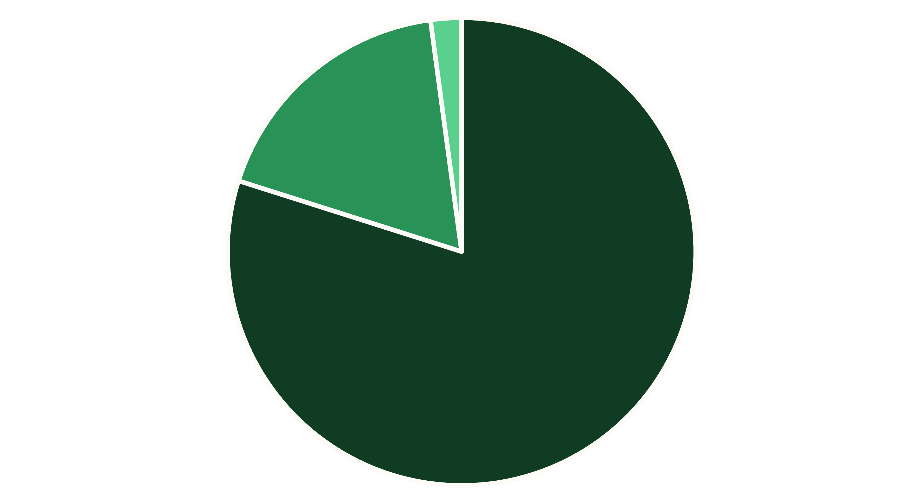
Customer Segmentation
Loyal
Returning
New
Loyal customers dominate at 80% of base. Focus on converting New and Returning segments.

Slide 6

Subscription Impact
Subscribers
Non-Subscribers
1,053 customers
2,847 customers
Avg Spend: $59.49
Avg Spend: $59.87
Total Revenue: $62,645
Total Revenue: $170,436
Non-subscribers represent 73% of revenue. Subscription growth opportunity identified.

Slide 7

Product Performance
Top Rated
1
Gloves (3.86), Sandals (3.84), Boots (3.82)
Discount Dependent
2
Hat (50%), Sneakers (49.66%), Coat (49.07%)
Most Purchased
3
Blouse (171), Jewelry (171), Pants (171)

Slide 8

Shipping & Discount Patterns
Shipping Comparison
Discount Strategy
Express: $60.48 avg
839 customers used discounts while spending above average
Standard: $58.46 avg
Discounts drive volume without sacrificing margins
Express users spend 3.5% more

Slide 9
Strategic Recommendations
1
Boost Subscriptions
2
Loyalty Programs
Promote exclusive benefits to unlock untapped revenue from 2,847 non-subscribers
Reward repeat buyers to strengthen the 701 Returning segment into Loyal status
3
Optimize Discounts
4
Targeted Marketing
Balance promotional strategy—high-discount products need margin review
Focus campaigns on high-revenue demographics and express-shipping users

Slide 10
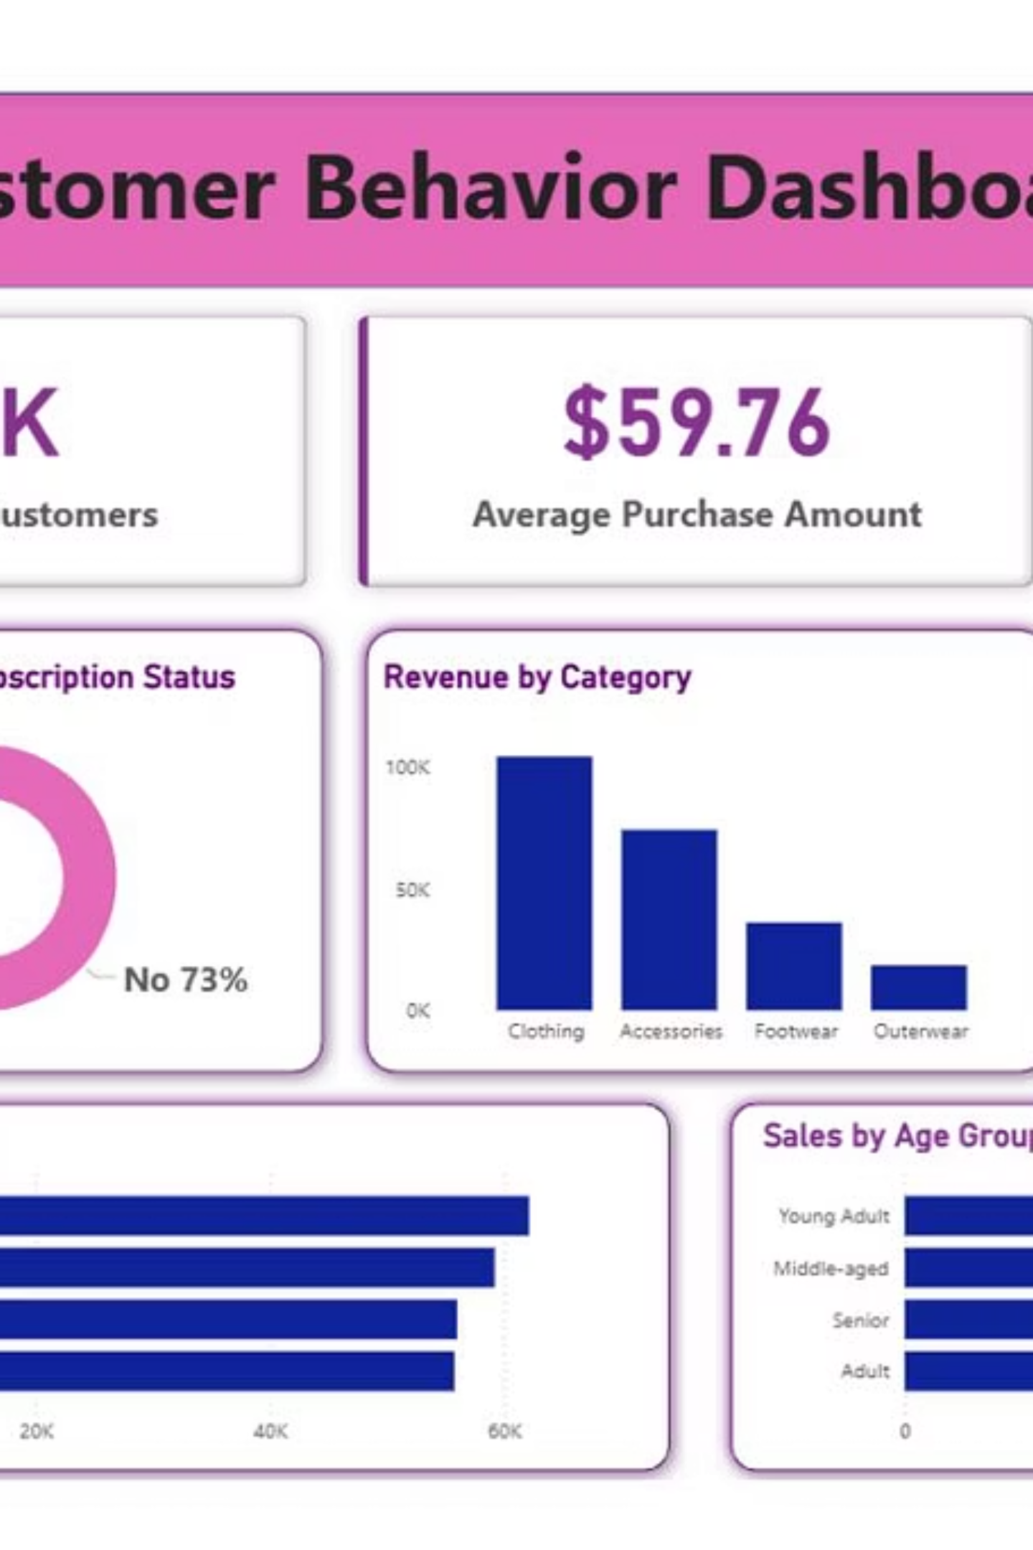
Interactive Dashboard
Power BI visualization consolidates all insights for real-time business monitoring and decision-making.
Ready to drive strategic growth through data-driven insights.

